Slide 1
Operating Systems
Dr. Deepak Dembla

Slide 2
Operating Systems

Slide 3
Objectives
The need for an Operating System (OS)
The evolution of Operating Systems
Batch processing systems
Multiprogramming systems
Multiuser systems
Multitasking systems
Multiprocessor systems
Distributed systems
Real time systems
Embedded systems
Goals of an operating system
Functions of Operating systems
Generic components of operating systems

Slide 4
Presents an environment for the user so that he or she can easily work without worrying about the hardware resources.
Manages all the resources in an efficient manner
Operating System Functions

Slide 5
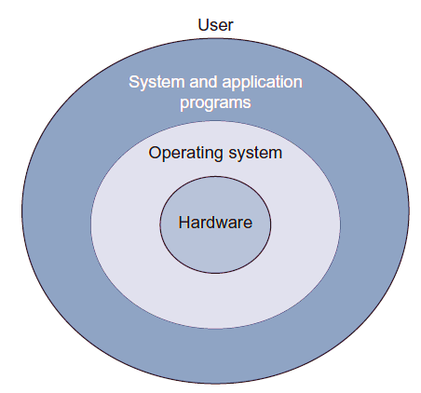
Computer System with Operating System

Slide 6
Evolution of Operating Systems
Generation | Period | Computer architecture | Problems and development of Operating systems
First | 1940s–1950s | Vacuum tubes based technology, plug boards and punched cards, magnetic core memories | No operating system

Slide 7
Evolution of Operating Systems
Generation | Period | Computer architecture | Problems and development of Operating systems
Second | 1950s–1960s | Transistors based technology, Mainframe computers, line printers, magnetic tapes, assemblers, linkers, loaders, compilers, FORTRAN, COBOL | Set up delay problem due to loading and unloading of tapes in earlier computer systems. CPU was idle. Jobs of users prepared with same programming language were batched together. Automated job sequencing Resident monitor Batch systems Mismatch between the speed of CPU and I/O devices Offline operation with magnetic tapes Tapes were sequential access devices

Slide 8
Evolution of Operating Systems
Generation | Period | Computer architecture | Problems and development of Operating systems
Third | 1960s–1980s | IC based technology, Minicomputer Magnetic disk | Hard disks came into existence Spooling Multiprogramming Multiprogrammed batch systems Lack of user/programmer interaction with their jobs in multiprogrammed batch systems Timesharing multiuser systems CTSS MULTICS UNICS UNIX Unix written in C

Slide 9
Evolution of Operating Systems
Generation | Period | Computer architecture | Problems and development of Operating systems
Fourth | 1980s–Present | LSI and VLSI based technology, Microcomputer | CP/M for PCs MS-DOS Multiuser facilities were not there in DOS XENIX OS/2 No user friendliness and convenience due to command driven and complex file systems Apple Macintosh Windows Multitasking Multithreading X-windows Motif Network operating systems Distributed operating systems

Slide 10
Types of Operating System
Type of operating system | Features/benefits | Example | Applicable to which type of application
Batch systems | More than one job can be stored in main memory Batches of same type of jobs can be executed quickly | FMS (FORTRAN monitor system), IBM’s operating system for 7094 | Background jobs in which the user interaction is not necessary
Multiuser systems | Jobs of different users who are connected to a main computer are executed through the multiprogramming Interaction of jobs with the user is possible Debugging is easy | CTSS by MIT, TSS by IBM, MULTICS, UNIX | When multiple users need to share a single system

Slide 11
Types of Operating System
Type of operating system | Features/benefits | Example | Applicable to which type of application
Multitasking systems | Multiple tasks of a single user can be opened on the system through multiprogramming | Windows | When a user wants to open and work simultaneously on many windows on the system
Network systems | The user is able to connect to another machine and perform many operations The user is aware of the location of the network node where he/she wants to connect | Novell Netware, Windows NT, Windows 2000, Windows XP, Sun Solaris | When a user wants to remote login on a system, wants to transfer a file, etc. on a network system

Slide 12
Types of Operating System
Type of operating system | Features/benefits | Example | Applicable to which type of application
Distributed systems | When multiple nodes of a wide network realized as a powerful machine sharing the resources on the network. The users are not aware where their processes are being sent and executed. | Amoeba, V system, Chorus | When computational speed and resource sharing is required and implemented through various full computer systems in a network
Real-time systems | Used to handle time-bound responses to the applications | pSOS, VxWorks, RTLinux, etc. | Applicable to systems which require time-bound response, i.e., for the real-time processing systems

Slide 13
Types of Operating System
Type of operating system | Features/benefits | Example | Applicable to which type of application
Embedded systems | Specialized systems with size, memory and power restrictions | Palm Pilot, Toshiba Pocket PC, Palm OS, Symbian OS, iPhone OS, RIM’s BlackBerry, Windows Phone, Linux, Palm WebOS, Android and Maemo. | Used in consumer electronics items, mobile phones, smart cards, etc.

Slide 14
Convenience
Hardware abstraction/Virtual machine
Convenient programming environment
Response time
Easy to use interface
Resource utilization/management
Protection
Goals of an Operating System

Slide 15
User view
User Interface
Program development and execution
Accessing I/O operations
Accessing File systems
Error detection
System view
Resource manager
Control Program
Virtual machine manager
Functions of Operating system

Slide 16
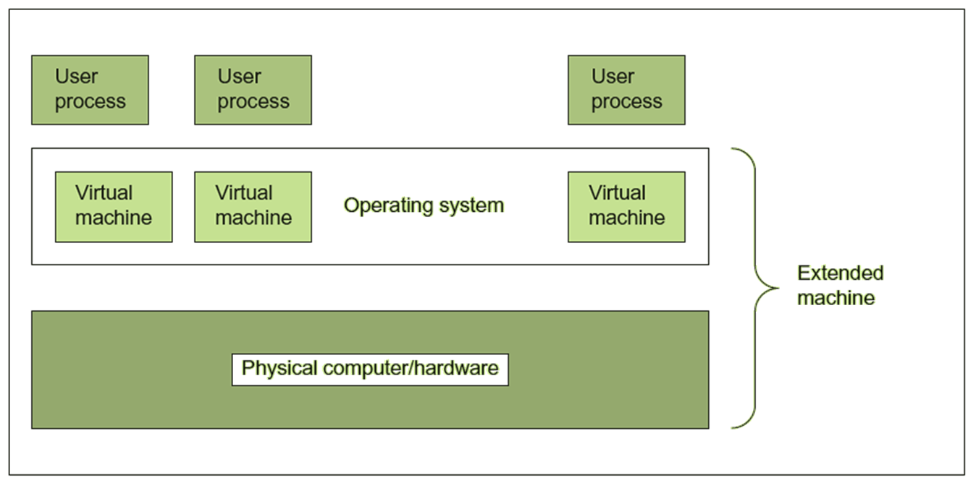
Operating system as a Virtual Machine Manager

Slide 17
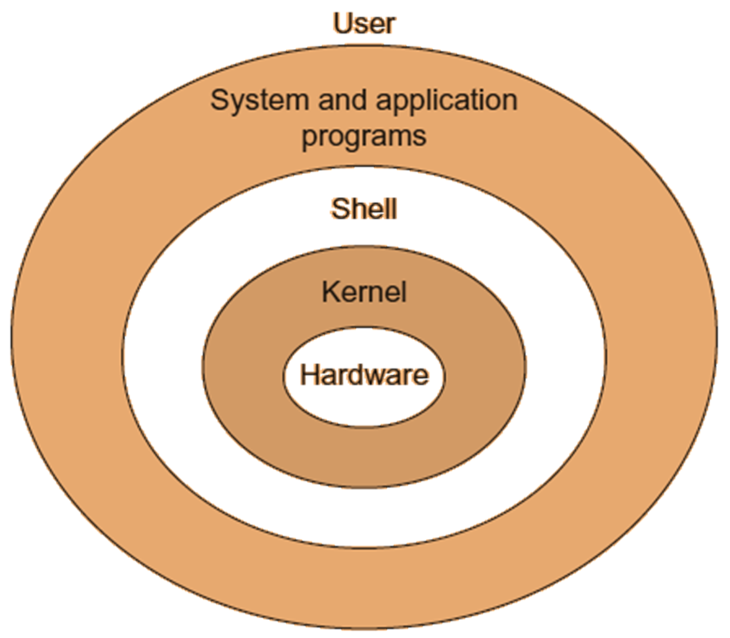
Operating System Generic Components
Operating system structure with shell and kernel

